Slide 1
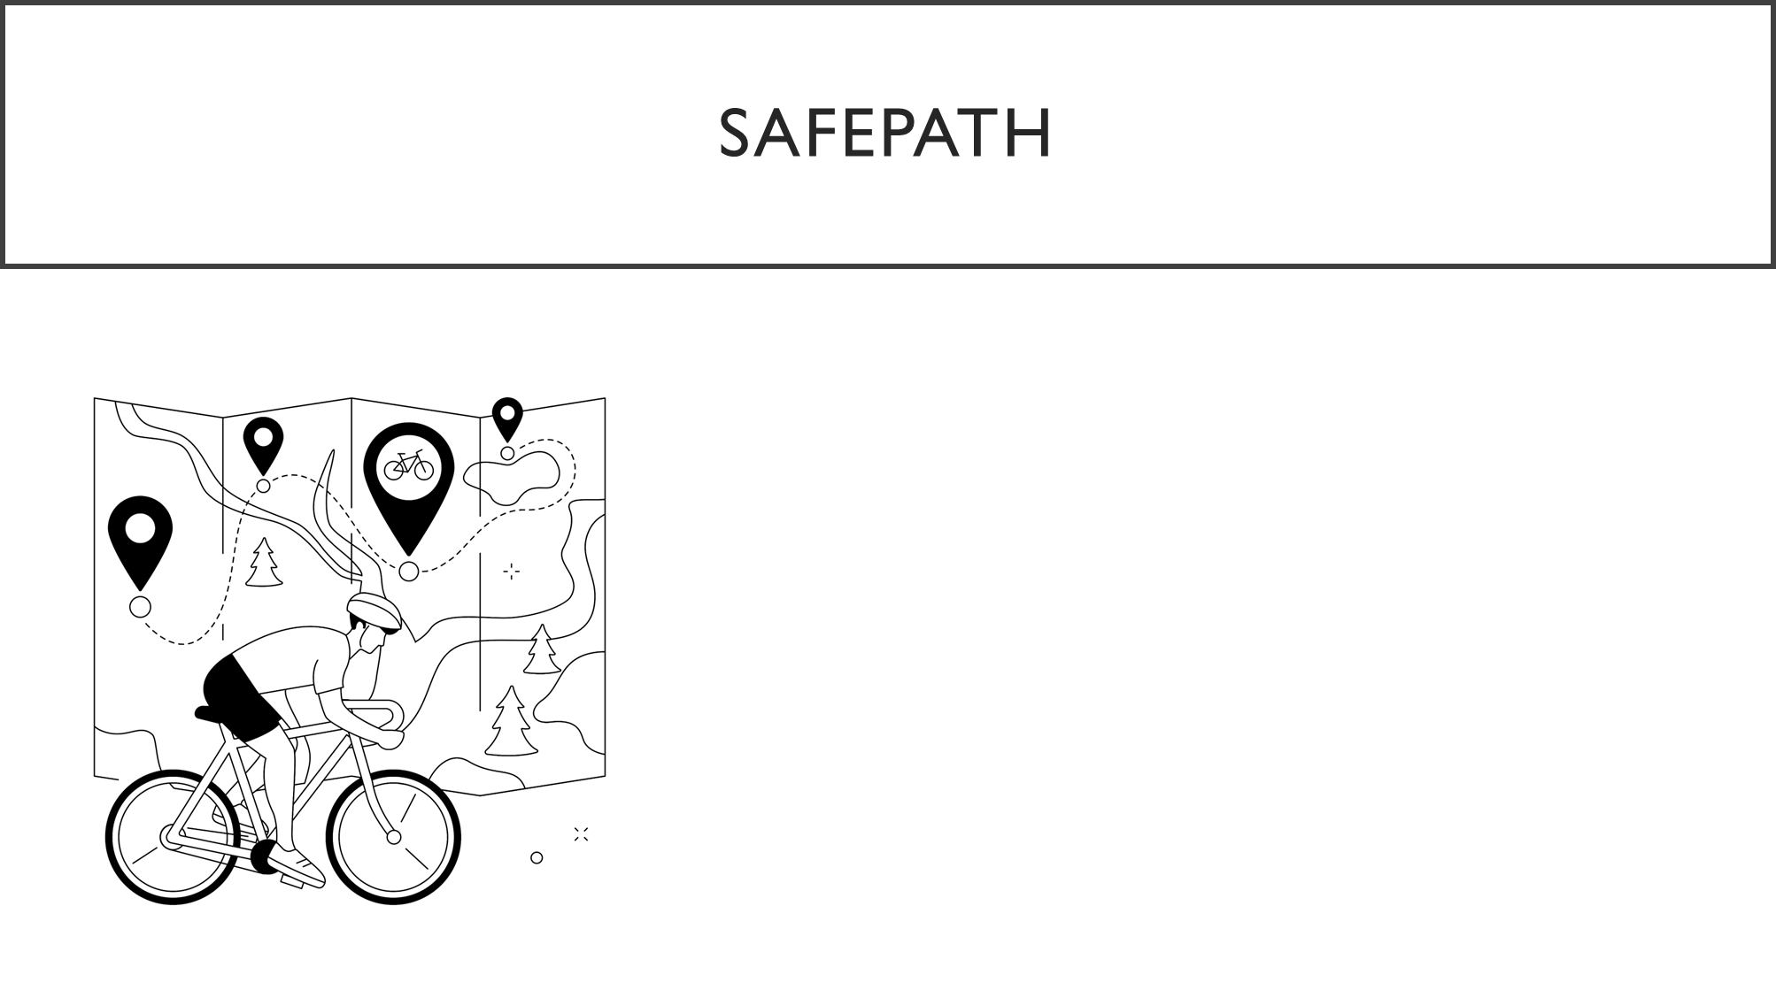
D24125555 – Karan Joseph – Team Lead
D24126048 – Shalini Kuruguntla
D24125575 – Sai Priyanka Basa Shanker
D24126339 – Huda Ibrahim
D24127853 – Hina Kausar

Slide 2

Leadership Overview – This Week
Tasks Completed this Week
Managed Jira board and tracked team tasks
Organized GitHub repository and reviewed pull requests
Read and summarized papers about data evaluation methods
Coordinated planning for next week’s activities
Focus for Next Week
Refine task assignments in Jira
Continue GitHub code reviews for consistency
Apply insights from evaluation papers into prototype design
Support team in preparing deliverables for next milestone

Slide 3
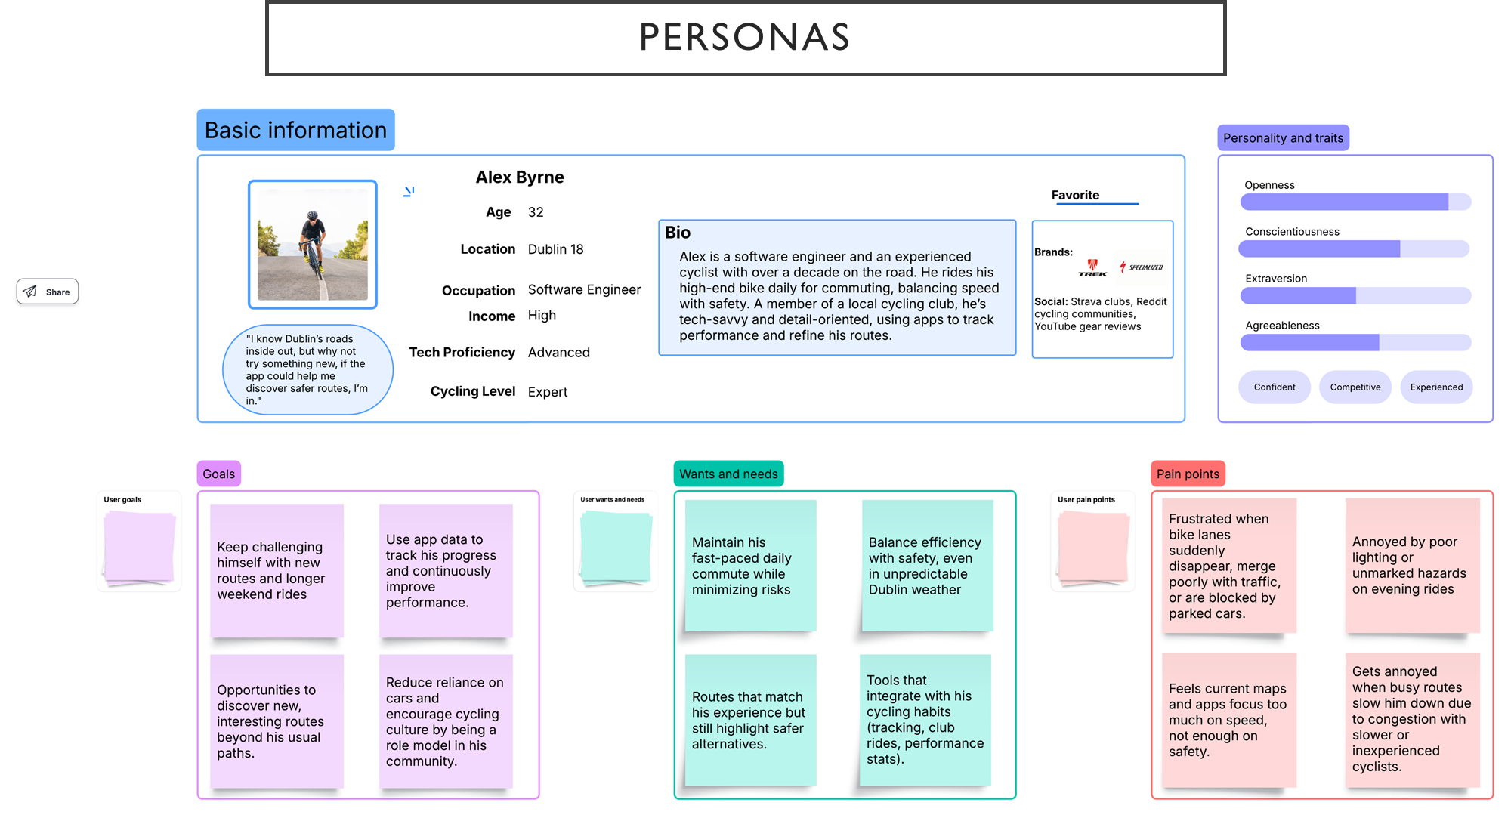
Expert Cyclist​

Slide 4
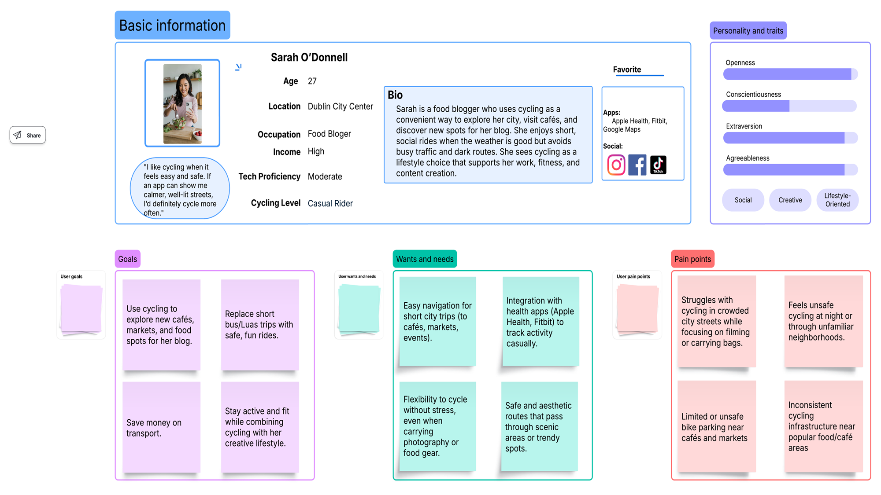
Casual Cyclist

Slide 5
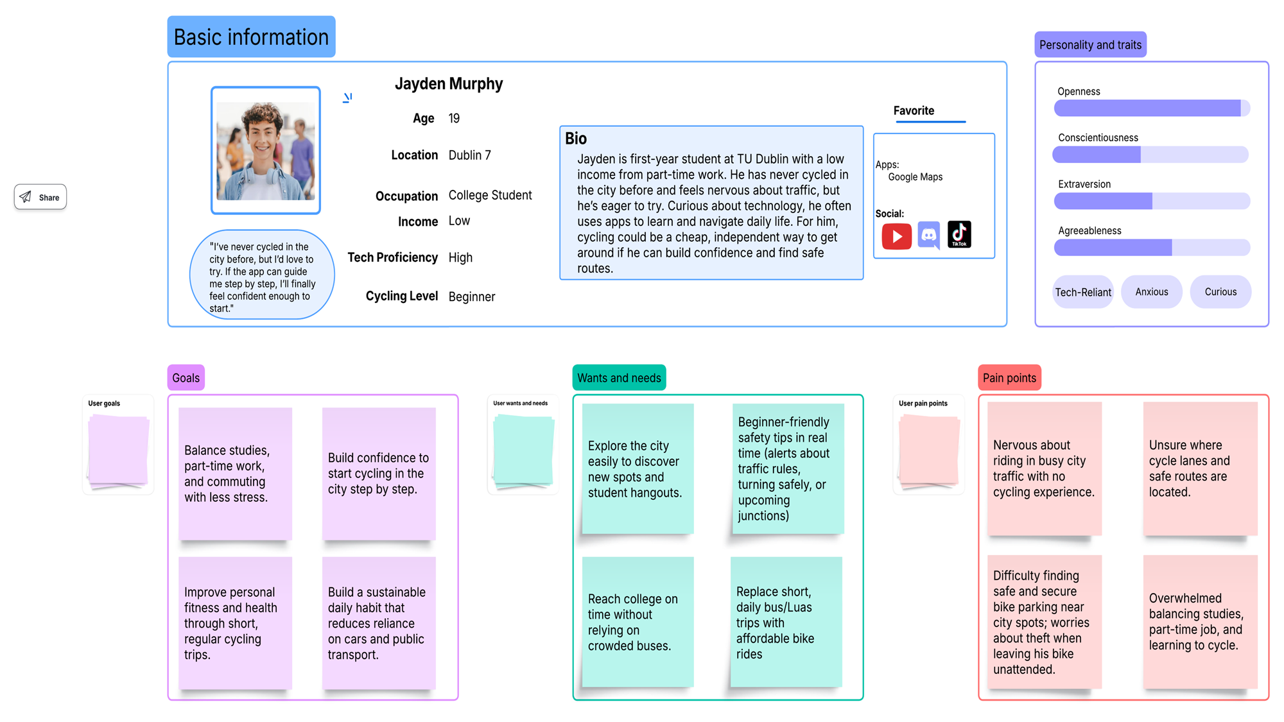
Beginner Cyclist

Slide 6
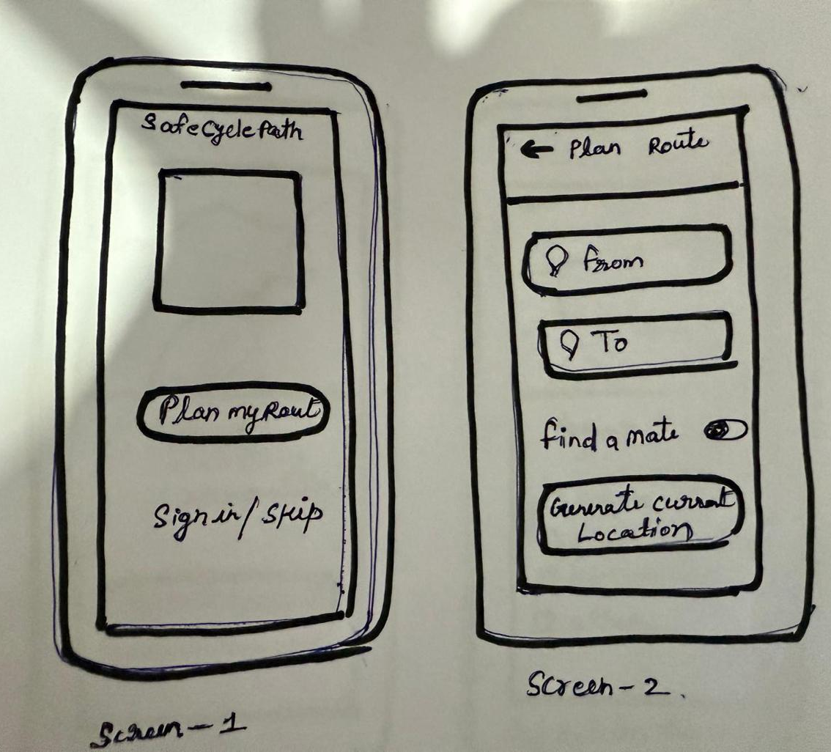
Low Fidelity
Main Home Page
Plan Route Page

Slide 7
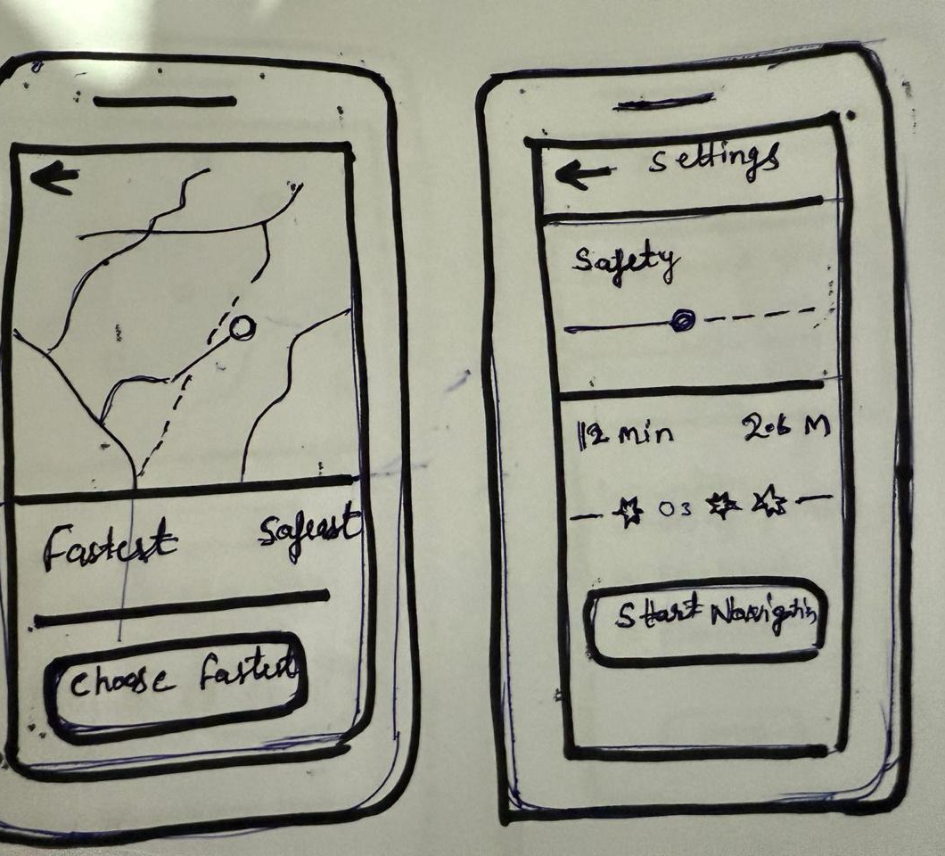
Low Fidelity
Route Suggestion Page
Settings Page

Slide 8
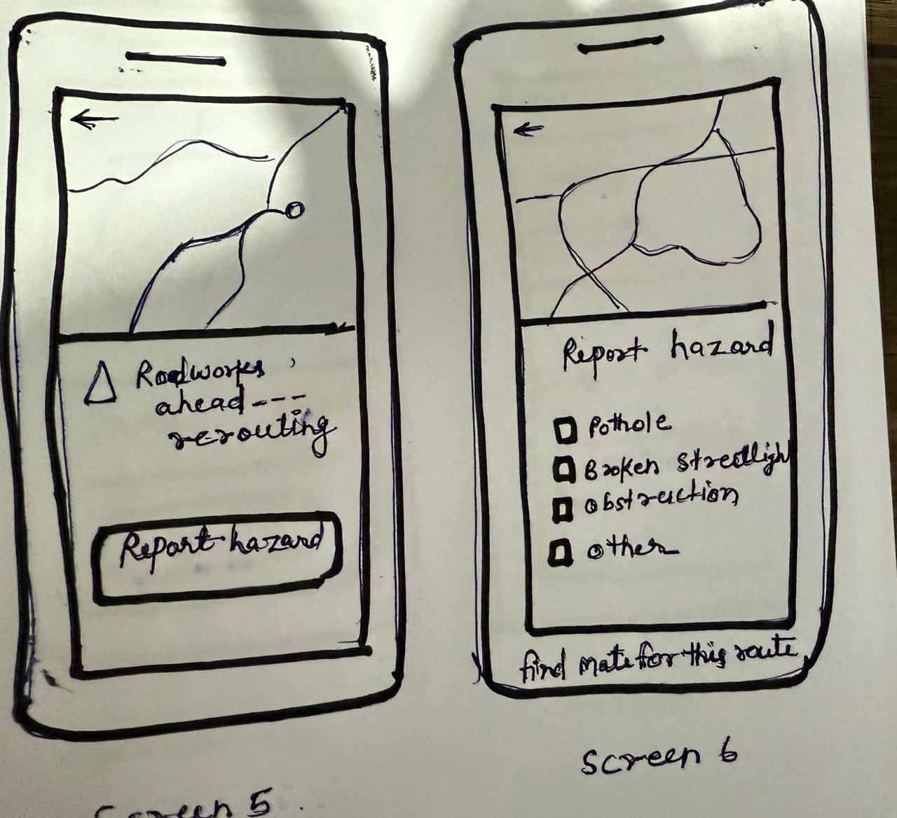
Low Fidelity
Report unsafe conditions

Slide 9
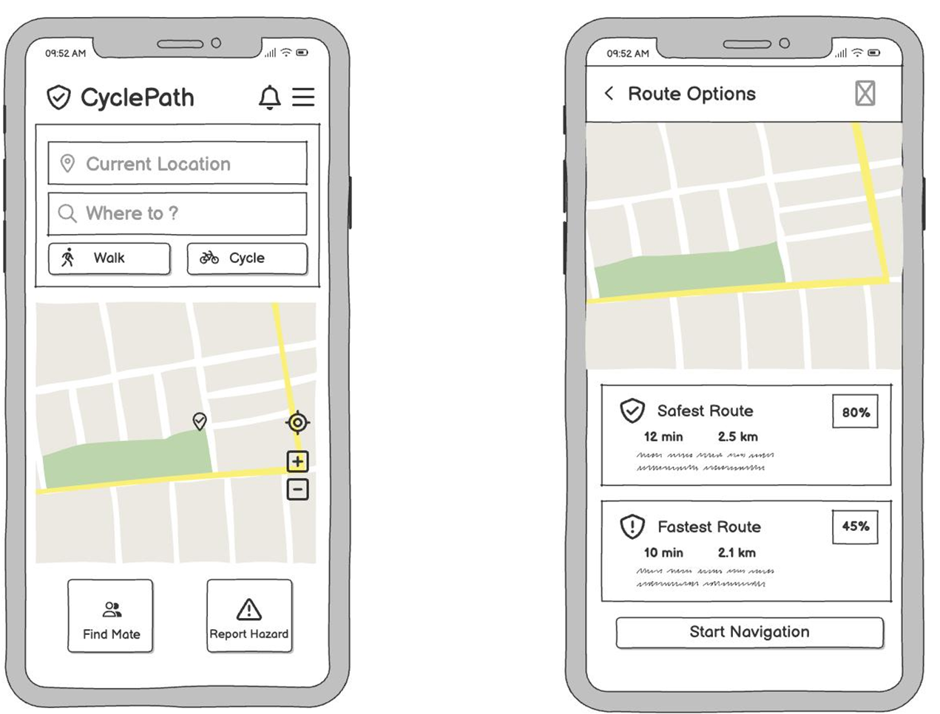
Wireframes

Slide 10
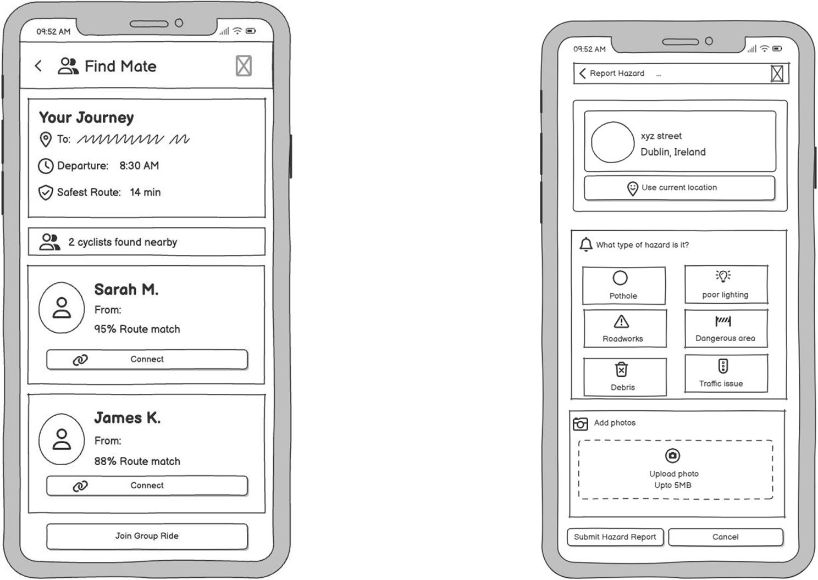
Wireframes

Slide 11
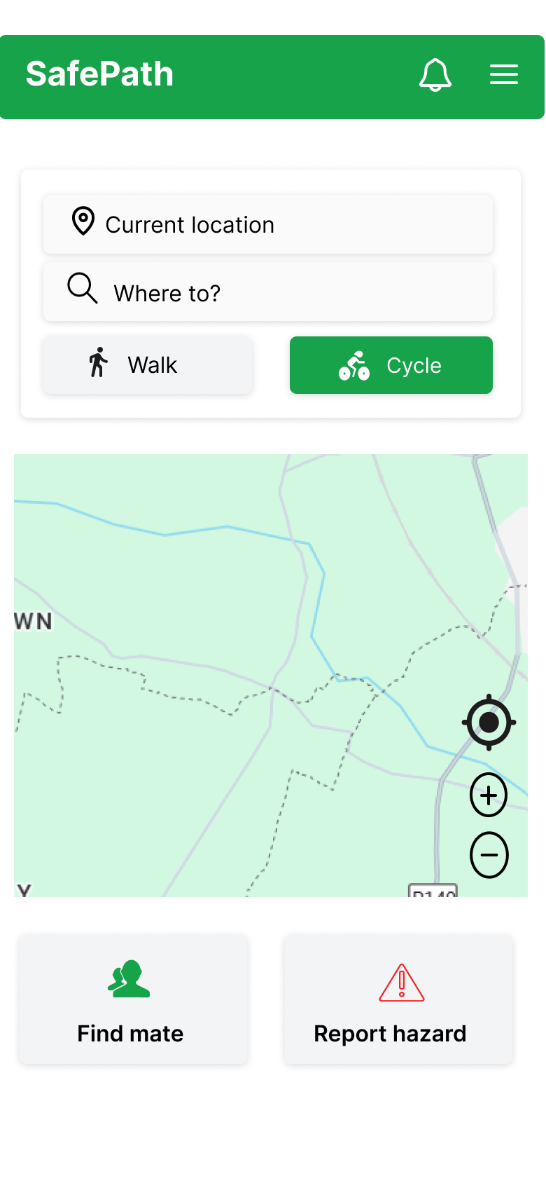
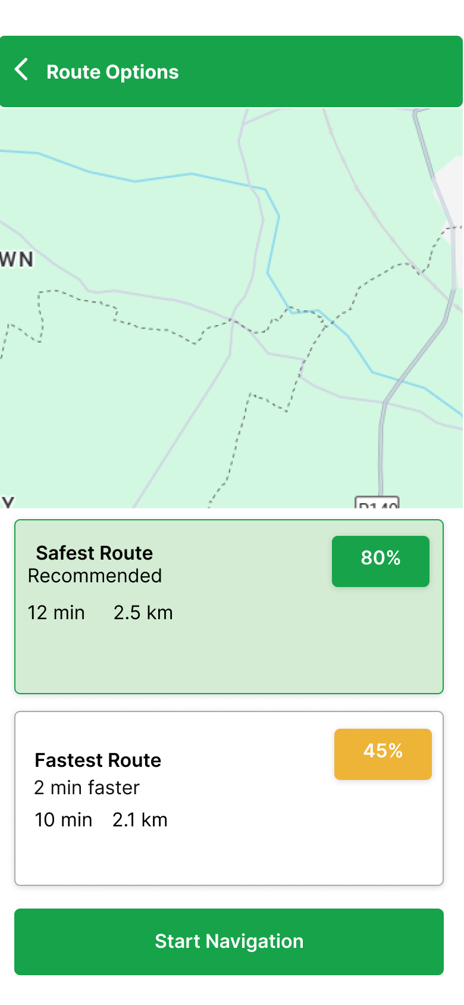
Medium Fidelity

Slide 12
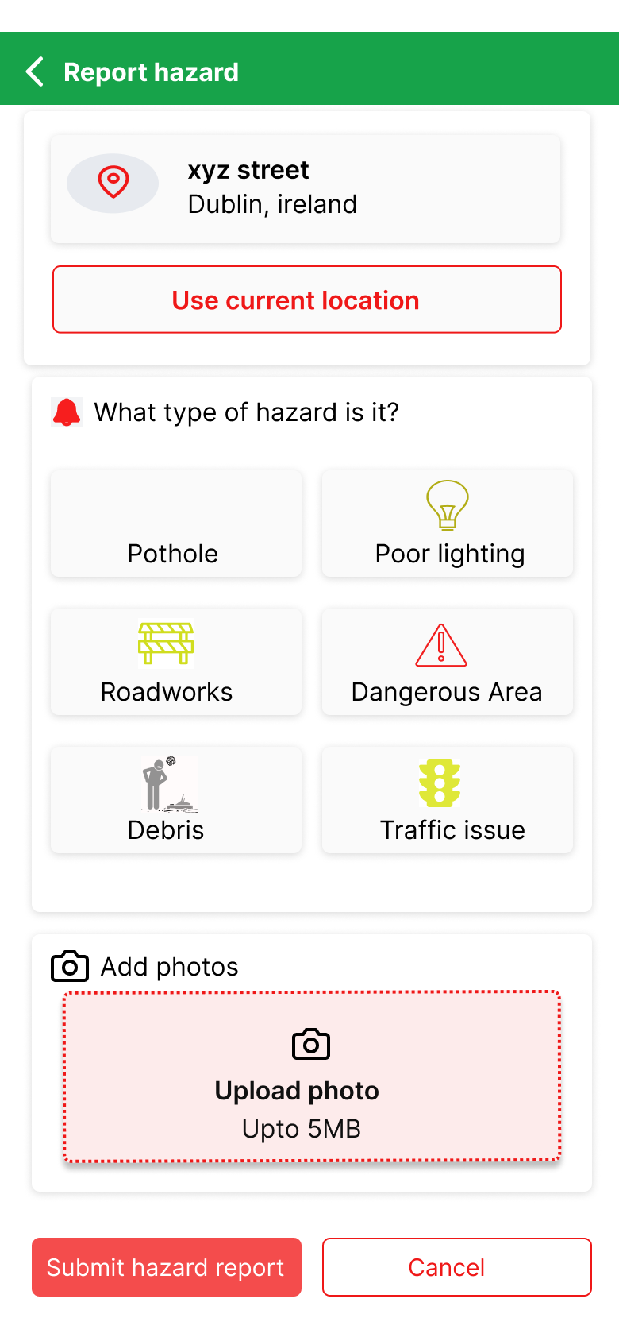
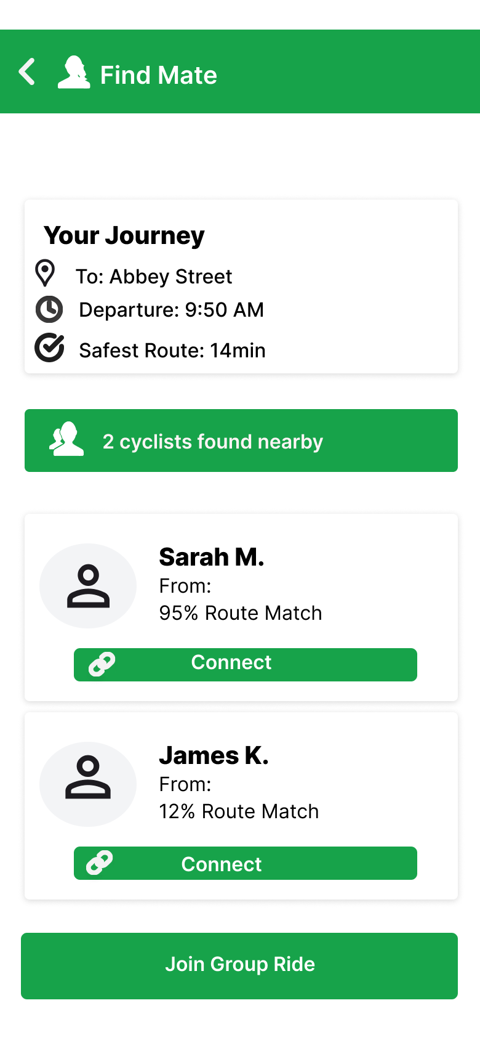
Medium Fidelity

Slide 13
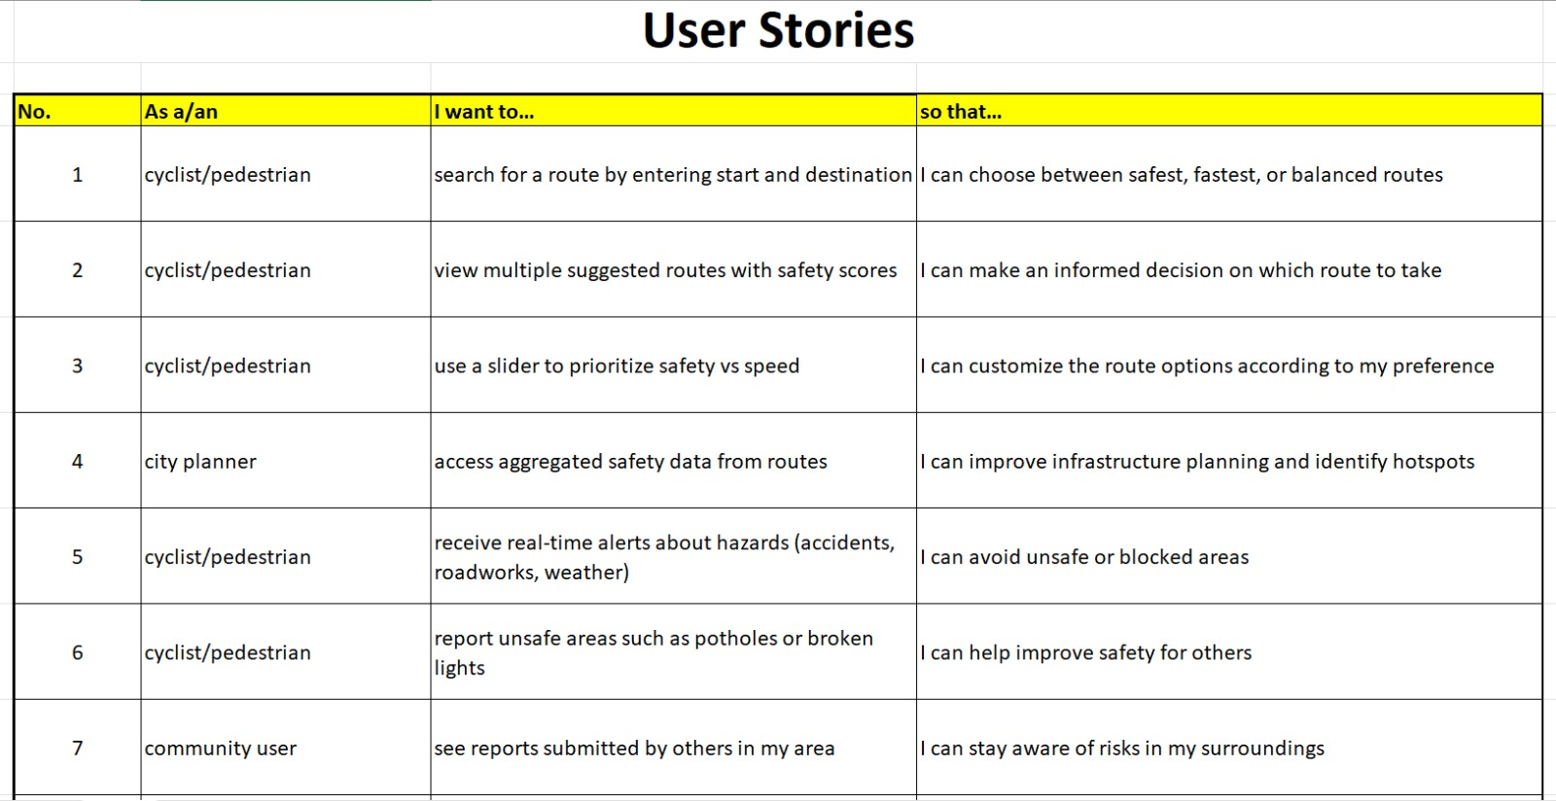

Slide 14
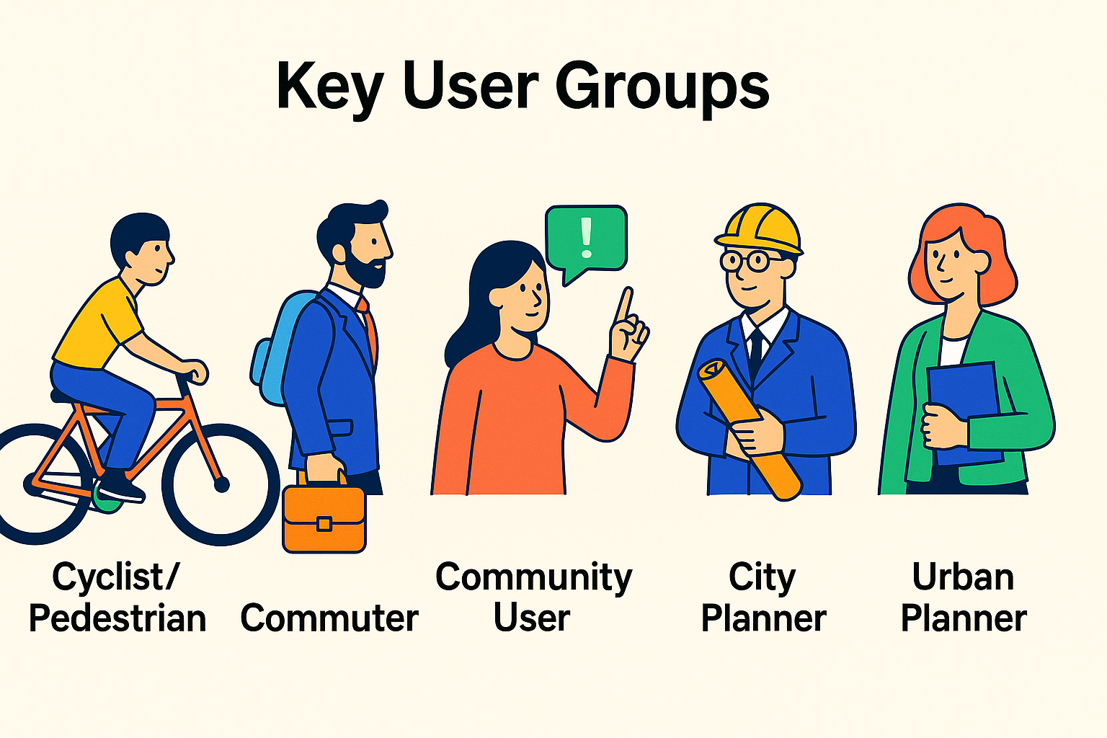
Key User Groups
Cyclist/Pedestrian People who walk or cycle in cities (students, workers, residents). Ex: TU Dublin student cycling to campus
Commuter Daily travellers to work, school, or university. Ex: Sandyford employee cycling to Leopardstown Business Park
Community User Residents are interested in neighbourhood safety beyond their own commute. Ex: Parent reporting a dark street near a school
City Planner
Local authorities faocus on infrastructure safety.
Ex: Dublin City Council uses reports to install streetlights
Urban Planner Designers of long-term urban transport policies and scaling. Ex: Transport authority using data for cycling policy

Slide 15
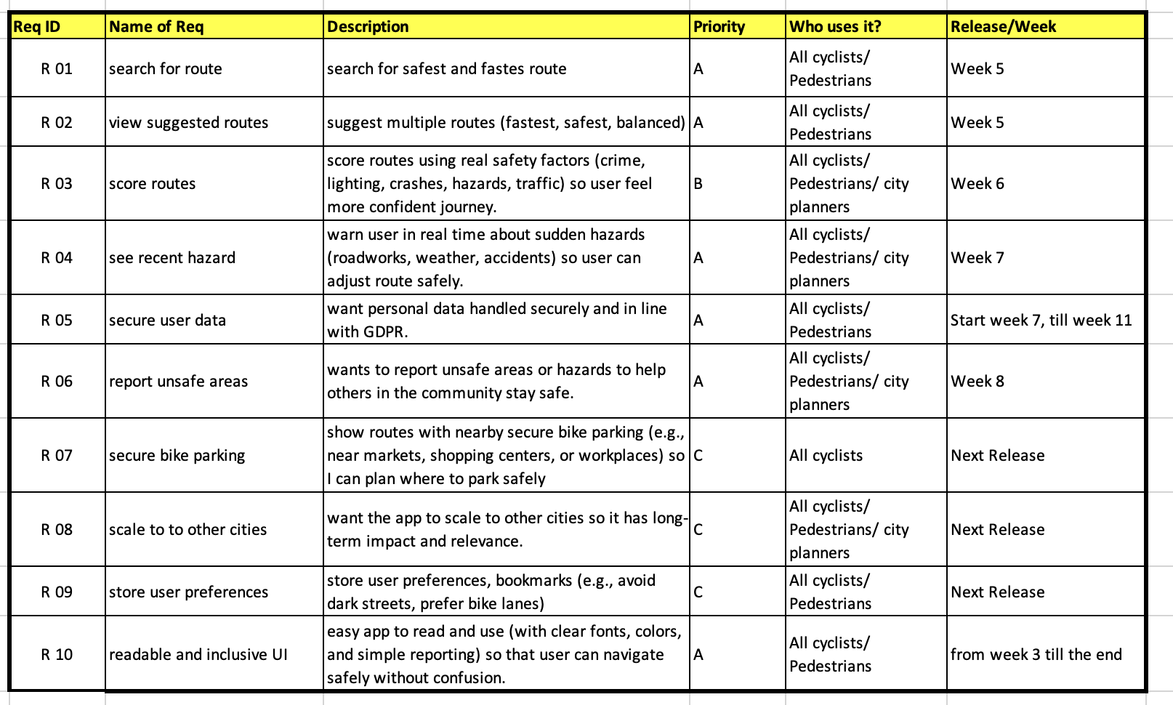
Requirements Specifications

Slide 16

Q & A
Thank you

